Slide 1
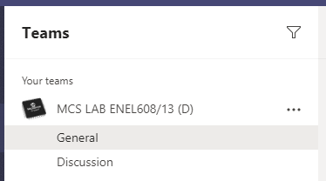

Lab Hand In and Grades
Navigate to your lab’s Teams group
Select “Assignments” to view the lab problems and submit your lab report
Select “Grades” to see all your work marked from Lab 5 onwards
Notes:
Grades for Lab 4 & 5 should now be available!

Slide 2
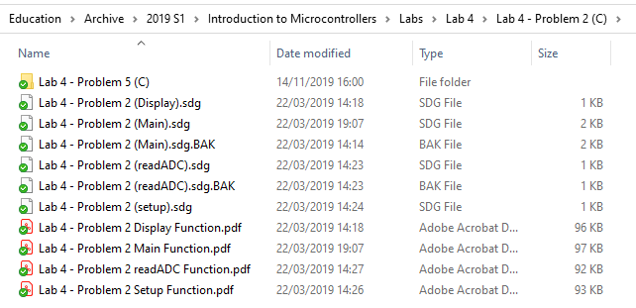
Creating Structure Diagrams
Make use of multiple files, by spreading out functions
One Function per file will make it easier to spread out content
You can copy + paste these files too if another problem uses the same function (readADC)
Notes:
Just be careful when copy + pasting and ensure the content is able to be copied without modification!
Structure Diagram program is available on Blackboard.

Slide 3
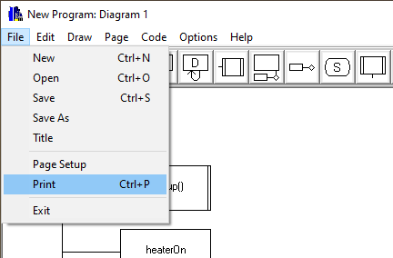
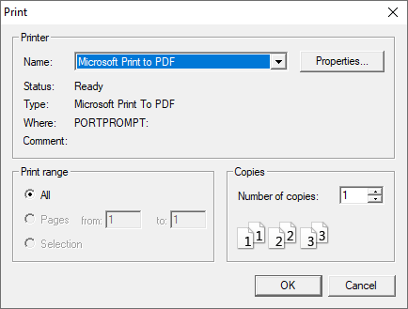
Exporting Structure Diagrams
Go to “File” -> “Print”
Select “Microsoft Print to PDF” and Save output file
Submit PDF with report OR Take screenshot of PDF and attach to report
Notes:
This method is useful when your screen is too small

Slide 4
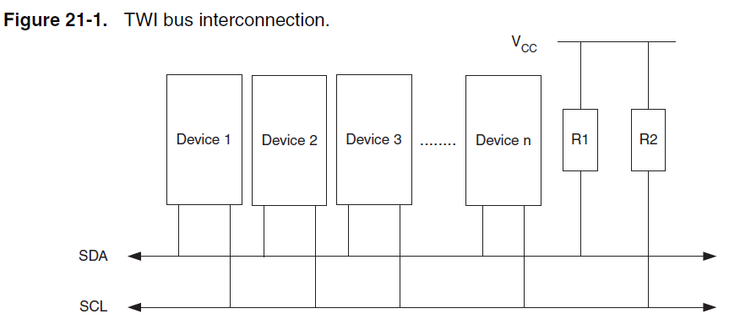
Two Wire Interface
Half Duplex – Transmit and receive data one at a time
Synchronous – Shared clock between the Master and Slave
Mutli-slave Multi-Master
The only protocol that transmits “Acknowledge” bits
There is one register that need to be set in the setup() to use TWI
  TWBR
Microchip AT90USB1287 Datasheet

Slide 5
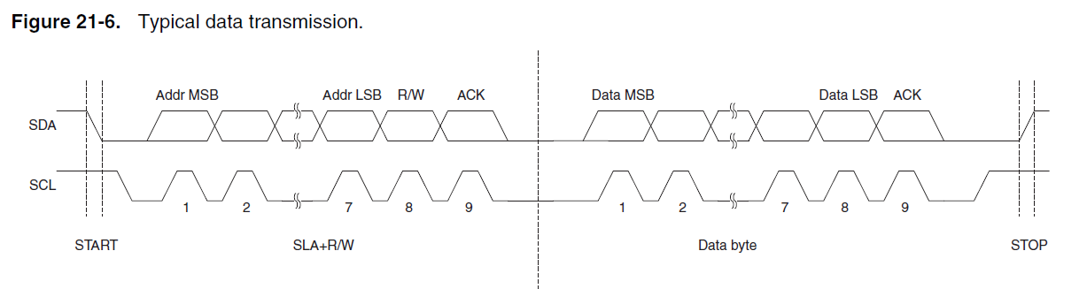
TWI – Data Transmission
Tell slave if we are to perform read or write
Note: ACK is sent from the receiver
The Start/Stop do not have a clock ‘pulse’
Clock Signal generated by μC, Tx over SCL line
Microchip AT90USB1287 Datasheet
Notes:
Note – the actual transmission will vary (depending on the slave device)

Slide 6
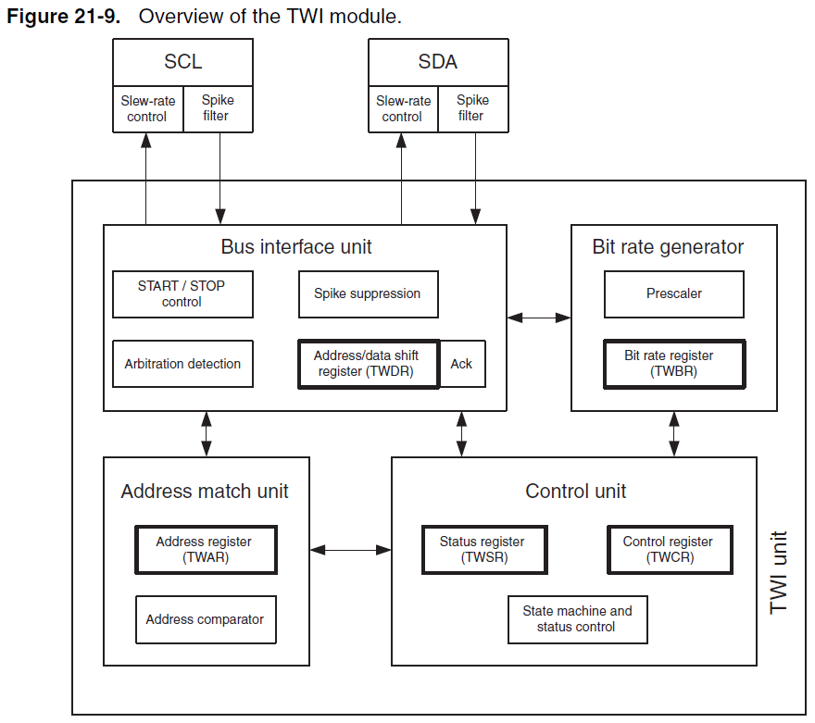
SPI – Block Diagram
The Clock (Bit rate generator)
  Based off the f_{osc}, and processed through prescaler
  Set using the TWBR Register
Bus Interface Unit
  Controls the flow of data out to the bus
  Also co-ordinates the clock and data transmission
  Stores the Address/Data in shift registers
  Stores the Acknowledge bit
Microchip AT90USB1287 Datasheet
Notes:
Note: Address Match Unit is used when the Micro is used as a slave – we will not cover this in our course

Slide 7
TWI – Transmission
Too much to fit on a PowerPoint Slide…
Notes:
See the reference material for the TWITx function.

Slide 8
TWITx Function
// Function Contrstuctor to Transmit data to a device over TWI with address 'slaveAddress’, register 'registerAddress’, and payload 'data’
char TWITx(char slaveAddress, char registerAddress, char data);
The TWITx Function completes the process of sending data over TWI
  It will facilitate the communication to a slave at slaveaddress, writing data to the register registerAddress
This function returns a char value
  Take a look at the function and how it works – if the value returned is 0, no issues are encountered in the transmission. If the value returned is 1, an issue has occurred in the TWI transmission and it should be repeated
  Hint: Use a while loop to run the code until the value returned is a 0!
The code is provided to you in your Microcontroller Manual (a.k.a TWIwrite())
  You are not expected to re-create the procedure for sending TWI Data – you can freely copy this function
  You are expected to make a Structure Diagram of this function
  You will still need to setup everything else (ex. addresses, format of the data, registers, #define statements)
  A courtesy copy of this function has been provided to you in your Assignment Materials - I have also made detailed comments to help you understand how this works
Notes:
You can thank me later ;)

Slide 9
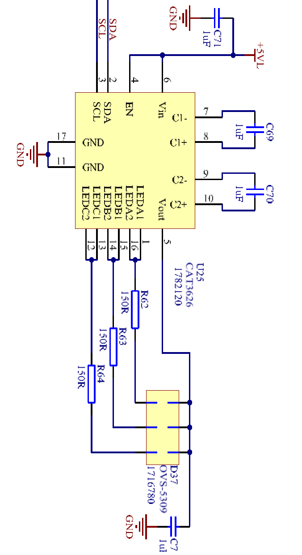
RGB LED
This week will require using the I²C LED
  The I²C LED can be contacted on slave address 0xCC
  All info is in Appendix H on Pg. 67 of the Lab Manual
The three colour channels (R,G,B) are controlled individually
  Each colour allows for 64 steps (~262k potential colours)
  Each colour corresponds to a group A, B, or C
    RegA is Green
    RegB is Red
    RegC is Blue
  The chip is capable of driving two sets of LED’s
    Channel 1 & 2 in our case have been driven together to supply more current to the LED
Ensure that you enable the LED’s colour groups in your setup() by setting RegEn
  The RegEn register can be contacted on register address 0x00
Image Attribution: Mark Beckerleg

Slide 10
RGB LED
The controller pulls pins down
  V_{out} is sent from the chip to LED’s.
  Each LEDxx Pin sinks the voltage to ground
  Capacitors reduce the ripples in the current due to PWM
One very important note
  The I²C LED also has functions that automatically configure the TWI and controls the LED channels and colours
  These commands are part of the Lab board library
  In this lab, you must manually perform commands to control the LED. You cannot use any of the library functions to control the RGB LED!
Image Attribution: Mark Beckerleg

Slide 11
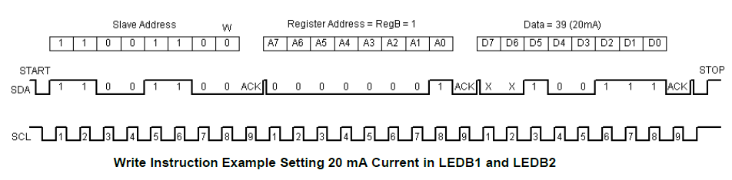
RGB LED
An example of transmitting data over the TWI
  Note: The TWITx Function completes the process of sending data over TWI (you don’t need to stress over this!)
Three blocks of data sent
  Slave Address
  Register Address
  Data
Image Attribution: Mark Beckerleg

Slide 12
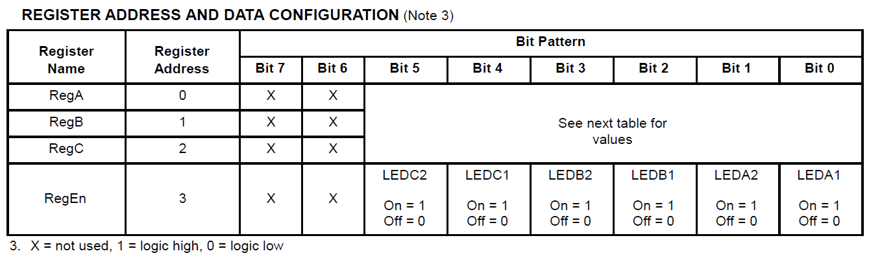
RGB LED
The LED’s have 6-bits of resolution
  Note: The two Most Significant Bit’s are ignored
Four Registers
  Reg A – C: Inidividual Colours
  RegEn: Enable or disable LED colours
Image Attribution: Mark Beckerleg

Slide 13
LCD Display
This week will require using the 20x4 Alphanumeric display
  Review the contents of your lab manual to see how this is setup
  The example on Page 24 is a good example to refer to
Call these functions in your setup()
  SLCDInit() – This will initiate the TWI serial protocol to allow your μC to talk to the LCD
  SLCDDisplayOn() – This will turn on the display to show characters
  SLCDClearScreen() – This will clear the screen of any existing content (such as the last students code)
The LCD is split into a 20 x 4 grid
  The top-left cell is position 0,0
  Use the SLCDSetCursorPosition(y,x) function to set the cursor position
  Use the SLCDWriteString(charArrayToWrite) function to place text on the screen
  The text needs to be in the form of a char array (use the sprintf() function)
Hello World!
PA2
PA1
PA0
x
y
H | E | L
0,0
1,2
Notes:
A quick reminder on the LCD Display (this the same as last weeks lab PowerPoint)

Slide 14
sprintf Function
// Example of using the sprintf function
char line0[20];
sprintf(line0, "temperature - %3d",tempSensorValue);
‘line0’ is the char array in which the string will be stored in
  This should be defined prior (as per the example above), and we set this to a blank array of 20 char values (since each line of the display can only show 20 characters)
‘temperature - %3d’ is the string we want to convert to show on the display
  %3d indicates that we intend to reserve three (‘3’) spaces for a decimal number (‘d’) to be displayed
‘tempSensorValue’ is the number we plan to substitute in this location
  The space we reserved earlier will be replaced by a 3-digit decimal number
Multiple variables can be used for the sprintf function
  See your lab manual for more information
Notes:
A quick reminder on the sprint() function (this the same as last weeks lab PowerPoint)

